Slide 2
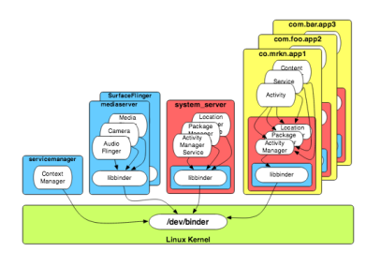
What is Binder
Comes from OpenBinder : allows processes to present interfaces which may be called by other threads.
A kernel driver to facilitate inter-process communication
Lightweight RPC (Remote Procedure Communication) mechanism.
Focused on scalability, stability,
flexibility, low-latency/overhead,
easy programming model
Essential to Android!
Notes:
RPC : RPC, which stands for Remote Procedure Calls, is a concept that tries to generalize a regular procedure invocation to a case where caller and receiver do not reside in the same process - and are potentially distributed across separate machines.
The essential goal of this approach is to make remote invocation as similar as possible to regular procedure calls and to hide the details of the physical connection.

Slide 3
Why Binder?
Memory management: “unneeded” processes are removed to free resources (mainly memory) for new ones
Binder to the rescue! Its built-in reference-counting of “object” references plus death-notification mechanism.
Per-process thread pool for processing requests
Synchronous and asynchronous (oneway) invocation model
Unique object-mapping across process boundaries
Each instance Binder objects maintains a unique identity across all processes in the system. This facility is provided by the Binder kernel driver, which analyzes the contents of each Binder transaction and assigns a unique 32-bit integer value to each Binder object it see.
How to mapping:
1: A virtual memory address pointing to a Binder object in the same process
2: A unique 32-bit handle (as assigned by the Binder kernel driver) pointing to the Binder’s virtual memory address in a different process.
Notes:
Mục tiêu chính của phương pháp này là làm cho lời gọi từ xa RPC tương tự như thể lời gọi thủ tục thông thường cục bộ và ẩn đi việc truyền dữ liệu đi về qua mạng

Slide 4
Binder Terminology
Binder Object: is an instance of a class that implements the Binder interface. A Binder object can implement multiple Binders.
Binder Protocol: The Binder middleware uses a very low-level protocol (ioctl-based) to communicate with the driver.
IBinder Interface: A Binder interface is a well-defined set of methods, properties, and events that a Binder can implement. It is usually described by the AIDL1 language.
Binder Token: A numeric value that uniquely identifies a Binder.
Binder Driver: The kernel-level driver that fascinates the communication across process boundaries
Notes:
Mục tiêu chính của phương pháp này là làm cho lời gọi từ xa RPC tương tự như thể lời gọi thủ tục thông thường cục bộ và ẩn đi việc truyền dữ liệu đi về qua mạng

Slide 5
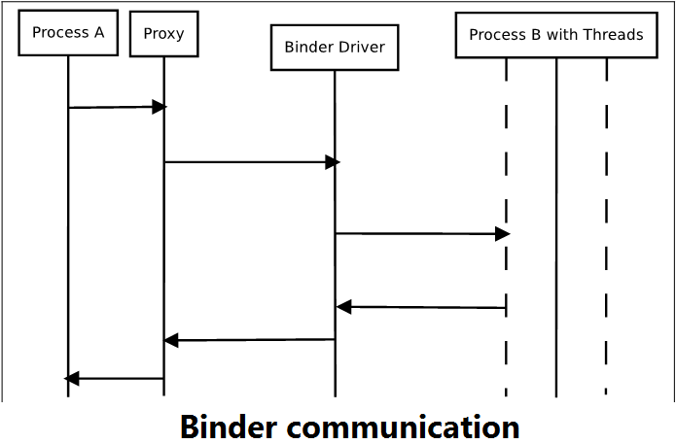
How to use Binder
The Binder framework communication is a client server model
Each client initiates communication and waits for response from the server.
Each client would have a proxy object for the client side communication
The server side constitutes a thread pool, shall spawn a new thread for each new Binder request from the client

Slide 6
What is AIDL
AIDL: Android Interface Definition Language , is similar to other IDLs , you might have worked with.
Allow to define the programming interface that both the client and service agree upon in order to communicate with each other using Binder
Possible to pass custom object, any primitive data across processes.
Notes:
IDLs describe an interface in a language-independent way, enabling communication between software components that do not share one language, for example, between those written in C++ and those written in Java

Slide 7
Why use AIDL?
AIDL does nothing but lets the system to generate the boilerplate code that hides the binder IPC detail
Don’t need AIDL when:
Don't need IPC (i.e., your client and server stay in the same process)
If you want to write the boilerplate code yourself for IPC

Slide 8
How to use AIDL

